Slide 1
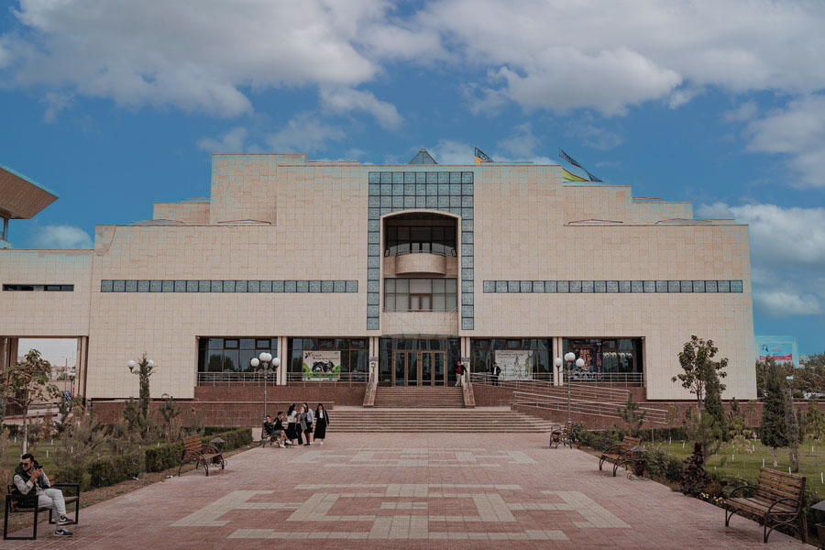


Full itinerary and detailed information about the trip.
Nukus City Tour
BEST CHOICE
BEST PRICES
RELIABLE TEAM

Slide 2

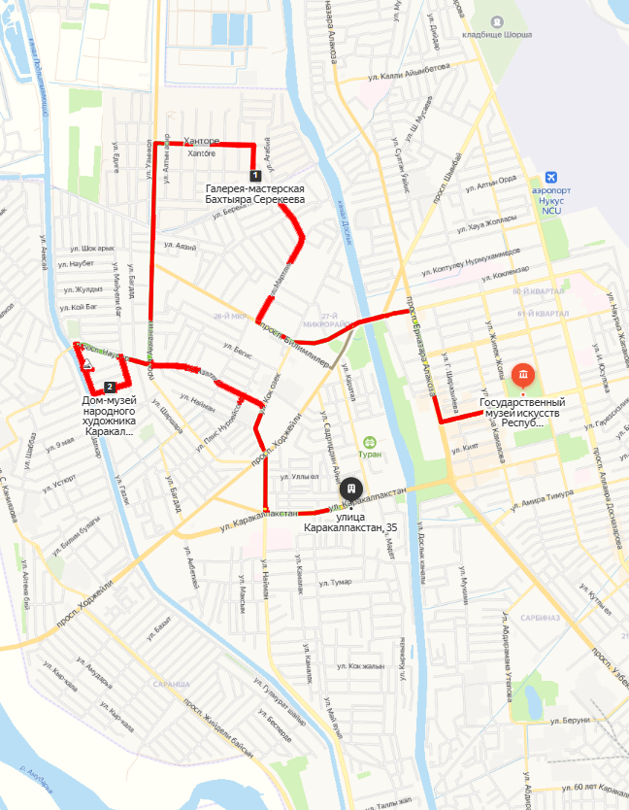

Trip itinerary
Duration:
1 day
Tour season:
Year-round
Total distance:
More than 13 km
Meals:
on request
Transport:
Sedan / Minibus

Slide 3

Day 1: Savitsky Museum - Bakhtiyar Serekbaev's Studio - Bazarbay Serekbaev's House Museum - Gyuldzhan Zarimov's Workshop - Bibisara Kunnazarova's Workshop
Start point:
Nukus city (Railway Station, Airport, Hotel, etc.)
Today you will have a creative tour, where every moment is saturated with inspiration and art. Our main goal is to discover the national flavor through the work of craftsmen who revive the forgotten crafts of the Karakalpaks.
9:00-12:00 Visit to the I.V.Savitsky Karakalpak State Museum of Art, which is a phenomenal Louvre in the desert and a place of pilgrimage for art historians. The museum has about 100,000 exhibits in the collection of which there is the art of ancient Khorezm, the folk applied art of the Karakalpaks, as well as the Avant-garde forgotten under the layer of several decades. Here you will discover not only the work of great masters, but also fundamentally new views on the history of Russian and Soviet art in a global context.
12:00-13:00 Visit to the House of the Museum of Bazarbai Serekeev, Honored Artist. This cozy corner is a repository of art. In the artist's family, you can taste the traditional Karakalpak dish in the yurt located in the courtyard of the museum.
14:00-14:30 We are heading to the studio of our contemporary, the son of the artist Bazarbai Serekeev, to Bakhtiyor Serekeev, where works in the Art Nouveau style are presented.
15:00-15:30 Visit to the workshop of Bibisara Kunnazarova, which revives carpets in the traditional way for the decoration of modern yurts. 15:45-16:30 Visit to the craftswoman, embroiderer, and fabric artist Gulnara Embergenova. The first craftswoman who revived the forgotten method of national embroidery of the Karakalpaks.
16:30-17:30 Stop at the Mahada craftswoman, who makes dolls in the national color.
The end of the tour.

Slide 4
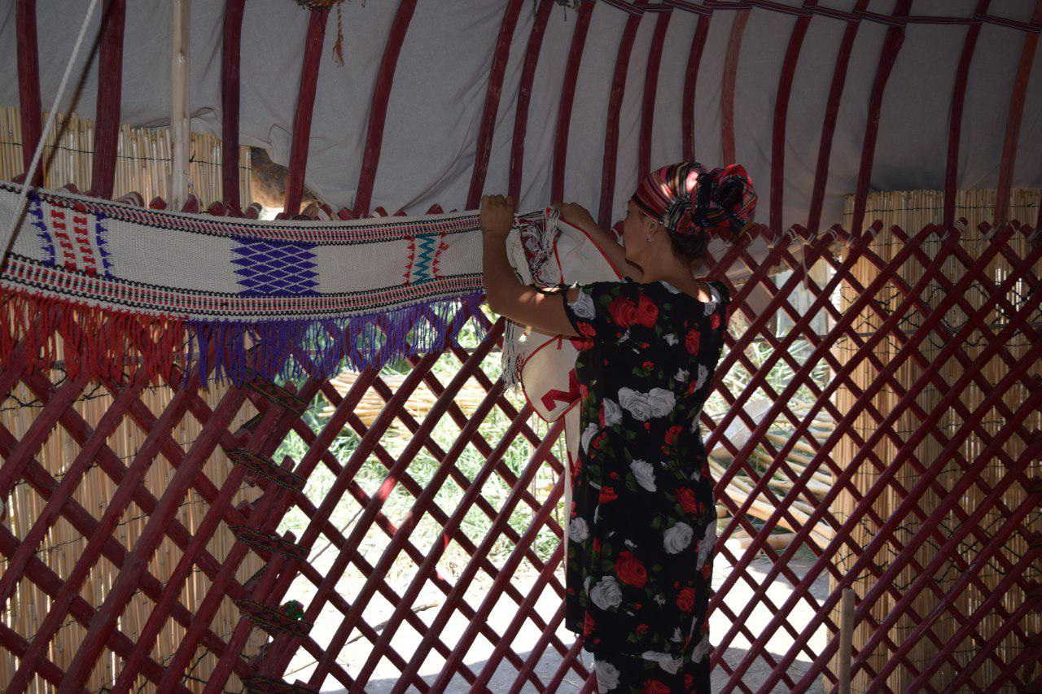
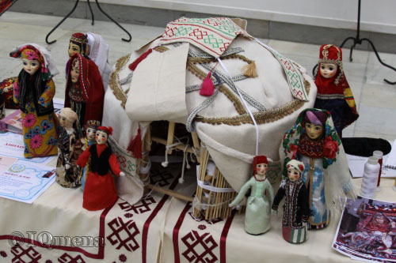
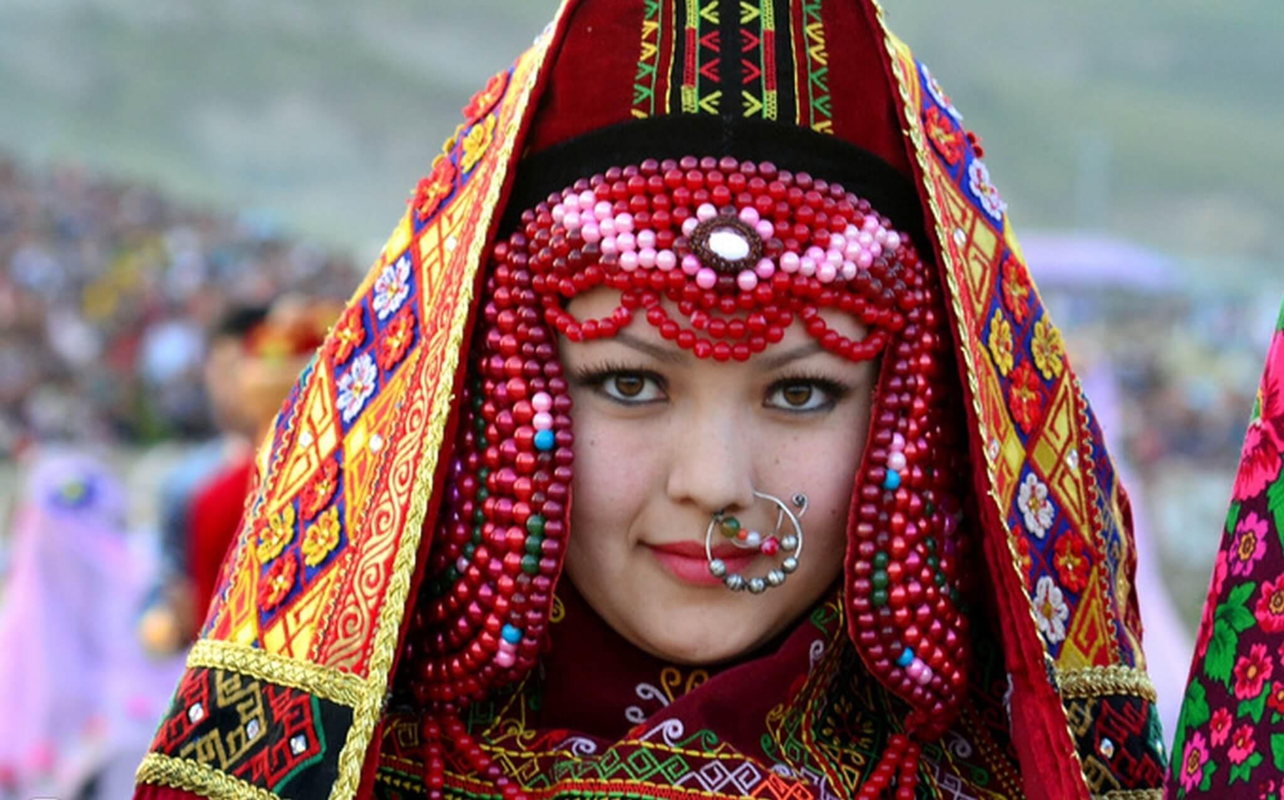
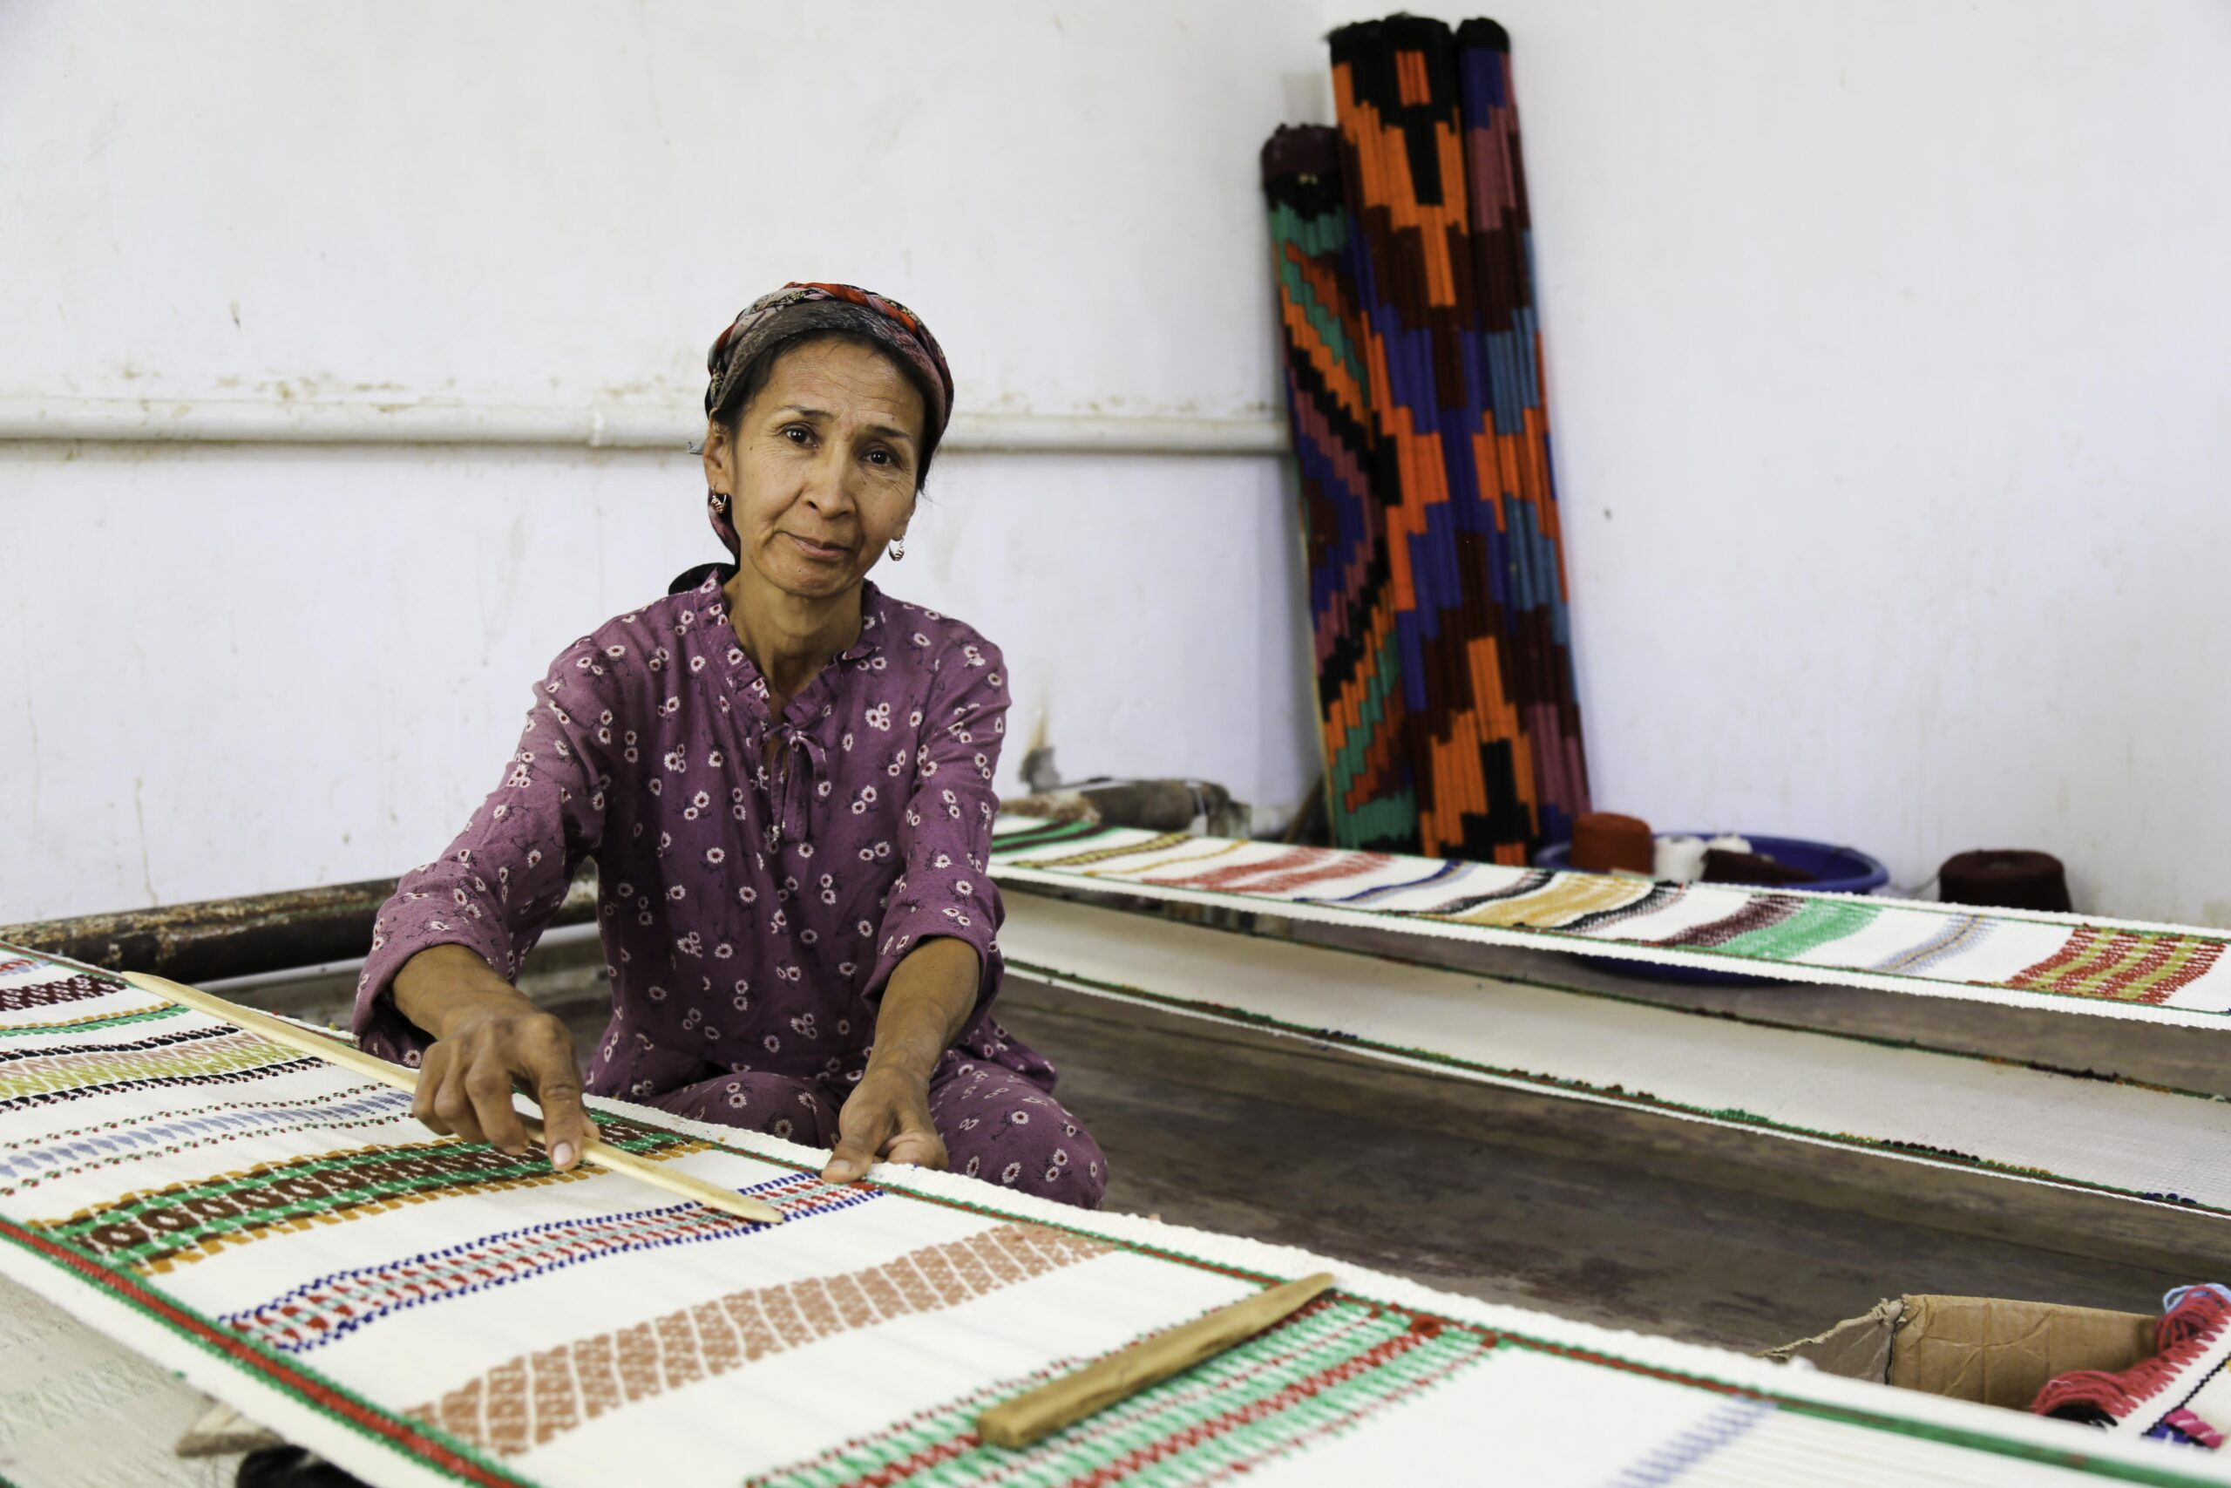
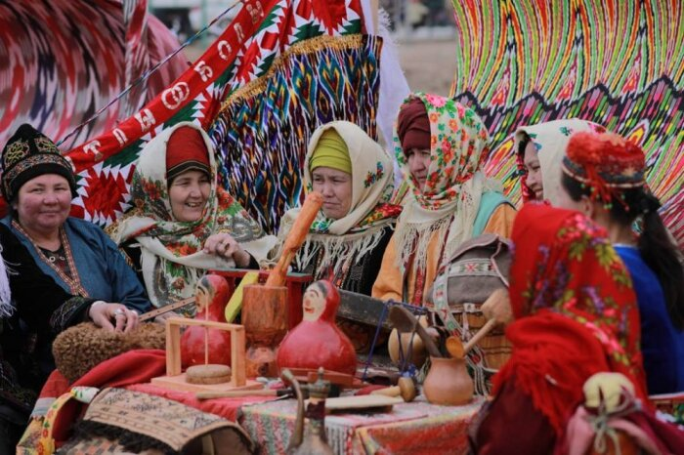
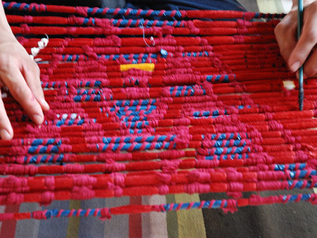

Slide 5
